Slide 1
Case study: Hadoop

Slide 2
Outline
Hadoop - Basics
HDFS
Goals
Architecture
Other functions
MapReduce
Basics
Word Count Example
Handy tools
Finding shortest path example
Related Apache sub-projects (Pig, HBase,Hive)

Slide 3
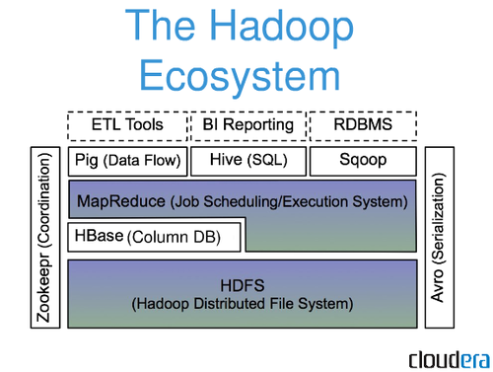
HBase: Part of Hadoop’s Ecosystem
HBase is built on top of HDFS
HBase files are internally stored in HDFS

Slide 4
Hadoop - Why ?
Need to process huge datasets on large clusters of computers
Very expensive to build reliability into each application
Nodes fail every day
Failure is expected, rather than exceptional
The number of nodes in a cluster is not constant
Need a common infrastructure
Efficient, reliable, easy to use
Open Source, Apache Licence

Slide 5
Who uses Hadoop?
Amazon/A9
Facebook
Google
New York Times
Veoh
Yahoo!
…. many more

Slide 6
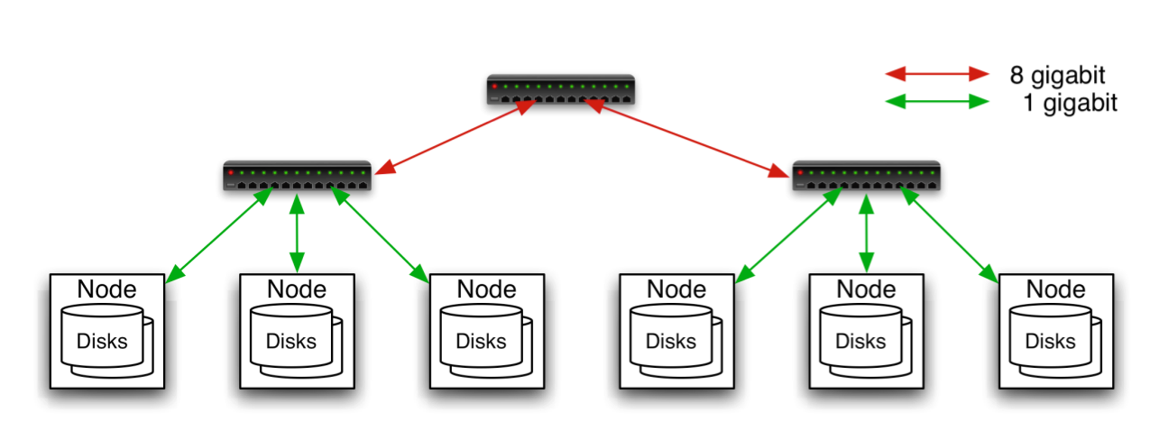
Commodity Hardware
Aggregation switch
Rack switch
Typically in 2 level architecture
Nodes are commodity PCs
30-40 nodes/rack
Uplink from rack is 3-4 gigabit
Rack-internal is 1 gigabit

Slide 7
Hadoop Distributed File System (HDFS)

Slide 8

Goals of HDFS
Very Large Distributed File System
10K nodes, 100 million files, 10PB
Assumes Commodity Hardware
Files are replicated to handle hardware failure
Detect failures and recover from them
Optimized for Batch Processing
Data locations exposed so that computations can move to where data resides
Provides very high aggregate bandwidth

Slide 9
Distributed File System
Single Namespace for entire cluster
Data Coherency
Write-once-read-many access model
Client can only append to existing files
Files are broken up into blocks
Typically 64MB block size
Each block replicated on multiple DataNodes
Intelligent Client
Client can find location of blocks
Client accesses data directly from DataNode

Slide 10

HDFS Architecture

Slide 11
Functions of a NameNode
Manages File System Namespace
Maps a file name to a set of blocks
Maps a block to the DataNodes where it resides
Cluster Configuration Management
Replication Engine for Blocks

Slide 12
NameNode Metadata
Metadata in Memory
The entire metadata is in main memory
No demand paging of metadata
Types of metadata
List of files
List of Blocks for each file
List of DataNodes for each block
File attributes, e.g. creation time, replication factor
A Transaction Log
Records file creations, file deletions etc

Slide 13
DataNode
A Block Server
Stores data in the local file system (e.g. ext3)
Stores metadata of a block (e.g. CRC)
Serves data and metadata to Clients
Block Report
Periodically sends a report of all existing blocks to the NameNode
Facilitates Pipelining of Data
Forwards data to other specified DataNodes

Slide 14
Block Placement
Current Strategy
One replica on local node
Second replica on a remote rack
Third replica on same remote rack
Additional replicas are randomly placed
Clients read from nearest replicas
Would like to make this policy pluggable

Slide 15
Heartbeats
DataNodes send hearbeat to the NameNode
Once every 3 seconds
NameNode uses heartbeats to detect DataNode failure

Slide 16
Replication Engine
NameNode detects DataNode failures
Chooses new DataNodes for new replicas
Balances disk usage
Balances communication traffic to DataNodes

Slide 17
Data Correctness
Use Checksums to validate data
Use CRC32
File Creation
Client computes checksum per 512 bytes
DataNode stores the checksum
File access
Client retrieves the data and checksum from DataNode
If Validation fails, Client tries other replicas

Slide 18
NameNode Failure
A single point of failure
Transaction Log stored in multiple directories
A directory on the local file system
A directory on a remote file system (NFS/CIFS)
Need to develop a real HA solution

Slide 19
Secondary NameNode
Copies FsImage and Transaction Log from Namenode to a temporary directory
Merges FSImage and Transaction Log into a new FSImage in temporary directory
Uploads new FSImage to the NameNode
Transaction Log on NameNode is purged

Slide 20
User Interface
Commads for HDFS User:
hadoop dfs -mkdir /foodir
hadoop dfs -cat /foodir/myfile.txt
hadoop dfs -rm /foodir/myfile.txt
Commands for HDFS Administrator
hadoop dfsadmin -report
hadoop dfsadmin -decommision datanodename
Web Interface
http://host:port/dfshealth.jsp

Slide 21
Pig

Slide 22

Pig
Started at Yahoo! Research
Now runs about 30% of Yahoo!’s jobs
Features
Expresses sequences of MapReduce jobs
Data model: nested “bags” of items
Provides relational (SQL) operators
(JOIN, GROUP BY, etc.)
Easy to plug in Java functions

Slide 23
An Example Problem
Load Users
Load Pages
Suppose you have user data in a file, website data in another, and you need to find the top 5 most visited pages by users aged 18-25
Filter by age
Join on name
Group on url
Count clicks
Order by clicks
Take top 5

Slide 24
In Pig Latin
Users = load ‘users’ as (name, age);
Filtered = filter Users by age >= 18 and age <= 25;
Pages = load ‘pages’ as (user, url);
Joined = join Filtered by name, Pages by user;
Grouped = group Joined by url;
Summed = foreach Grouped generate group, count(Joined) as clicks;
Sorted = order Summed by clicks desc;
Top5 = limit Sorted 5;
store Top5 into ‘top5sites’;

Slide 25
Ease of Translation
Load Users
Load Pages
Users = load … Fltrd = filter … Pages = load … Joined = join … Grouped = group … Summed = … count()… Sorted = order … Top5 = limit …
Filter by age
Join on name
Group on url
Count clicks
Order by clicks
Take top 5

Slide 26
Ease of Translation
Load Users
Load Pages
Users = load … Fltrd = filter … Pages = load … Joined = join … Grouped = group … Summed = … count()… Sorted = order … Top5 = limit …
Filter by age
Join on name
Job 1
Group on url
Job 2
Count clicks
Order by clicks
Job 3
Take top 5

Slide 27
HBase

Slide 28
HBase - What?
Modeled on Google’s Bigtable
Row/column store
Billions of rows/millions on columns
Column-oriented - nulls are free
Untyped - stores byte[]

Slide 29
HBase - Data Model
Row | Timestamp | Column family: animal: |  | Column family repairs:
 |  | animal:type | animal:size | repairs:cost
enclosure1 | t2 | zebra |  | 1000 EUR
 | t1 | lion | big
enclosure2 | … | … | … | …

Slide 30
HBase - Data Storage
Column family animal:
(enclosure1, t2, animal:type) | zebra
(enclosure1, t1, animal:size) | big
(enclosure1, t1, animal:type) | lion
Column family repairs:
(enclosure1, t1, repairs:cost) | 1000 EUR

Slide 31
HBase - Code
HTable table = …
Text row = new Text(“enclosure1”);
Text col1 = new Text(“animal:type”);
Text col2 = new Text(“animal:size”);
BatchUpdate update = new BatchUpdate(row);
update.put(col1, “lion”.getBytes(“UTF-8”));
update.put(col2, “big”.getBytes(“UTF-8));
table.commit(update);
update = new BatchUpdate(row);
update.put(col1, “zebra”.getBytes(“UTF-8”));
table.commit(update);

Slide 32
HBase - Querying
Retrieve a cell
Cell = table.getRow(“enclosure1”).getColumn(“animal:type”).getValue();
Retrieve a row
RowResult = table.getRow( “enclosure1” );
Scan through a range of rows
Scanner s = table.getScanner( new String[] { “animal:type” } );

Slide 33
Hive

Slide 34

Hive
Developed at Facebook
Used for majority of Facebook jobs
“Relational database” built on Hadoop
Maintains list of table schemas
SQL-like query language (HiveQL)
Can call Hadoop Streaming scripts from HiveQL
Supports table partitioning, clustering, complex data types, some optimizations

Slide 35
Creating a Hive Table
CREATE TABLE page_views(viewTime INT, userid BIGINT,
page_url STRING, referrer_url STRING,
ip STRING COMMENT 'User IP address')
COMMENT 'This is the page view table'
PARTITIONED BY(dt STRING, country STRING)
STORED AS SEQUENCEFILE;
Partitioning breaks table into separate files for each (dt, country) pair
Ex: /hive/page_view/dt=2008-06-08,country=USA
/hive/page_view/dt=2008-06-08,country=CA

Slide 36
A Simple Query
Find all page views coming from xyz.com on March 31st:
SELECT page_views.*
FROM page_views
WHERE page_views.date >= '2008-03-01'
AND page_views.date <= '2008-03-31'
AND page_views.referrer_url like '%xyz.com';
Hive only reads partition 2008-03-01,* instead of scanning entire table

Slide 37
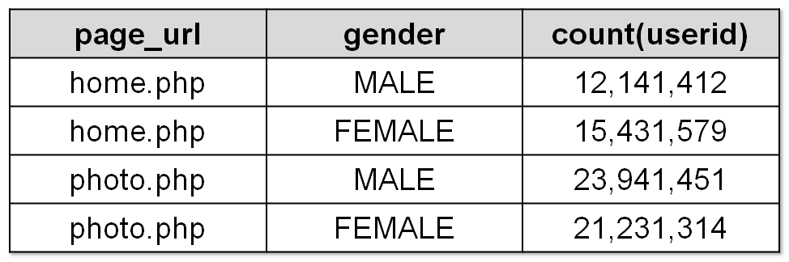
Aggregation and Joins
Count users who visited each page by gender:
Sample output:
SELECT pv.page_url, u.gender, COUNT(DISTINCT u.id)
FROM page_views pv JOIN user u ON (pv.userid = u.id)
GROUP BY pv.page_url, u.gender
WHERE pv.date = '2008-03-03';

Slide 38
Using a Hadoop Streaming Mapper Script
SELECT TRANSFORM(page_views.userid, page_views.date)
USING 'map_script.py'
AS dt, uid CLUSTER BY dt
FROM page_views;

Slide 39
Storm

Slide 40

Storm
Developed by BackType which was acquired by Twitter
Lots of tools for data (i.e. batch) processing
Hadoop, Pig, HBase, Hive, …
None of them are realtime systems which is becoming a real requirement for businesses
Storm provides realtime computation
Scalable
Guarantees no data loss
Extremely robust and fault-tolerant
Programming language agnostic

Slide 41
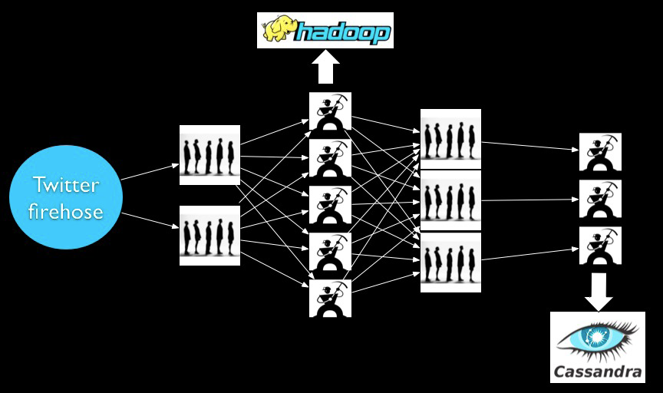
Before Storm

Slide 42
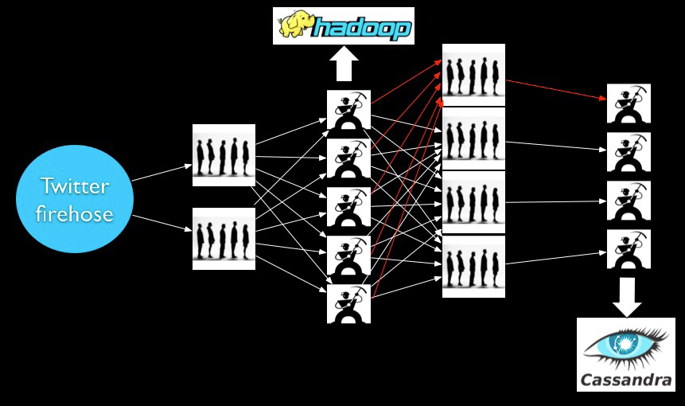
Before Storm – Adding a worker
Deploy
Reconfigure/Redeploy

Slide 43
Problems
Scaling is painful
Poor fault-tolerance
Coding is tedious

Slide 44
What we want
Guaranteed data processing
Horizontal scalability
Fault-tolerance
No intermediate message brokers!
Higher level abstraction than message passing
“Just works” !!

Slide 45
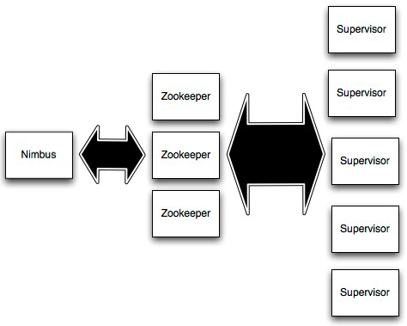
Storm Cluster
Master node (similar to
Hadoop JobTracker)
Used for cluster coordination
Run worker processes

Slide 46
Streams
Tuple
Tuple
Tuple
Tuple
Tuple
Tuple
Tuple
Unbounded sequence of tuples

